Slide 1
CSC312
Automata Theory
Lecture # 6
Chapter # 5 by Cohen
Finite Automata

Slide 2
Automaton
An automaton is an abstract model of a computer, which accepts some input (a string), produces output (yes/no or a string), and may have internal, storage (usually, as stack or tape).
An automaton operates in a discrete time frame (like a real computer). A particular state of the automaton, including the stat of the control unit, input, and storage, is called a configuration.

Slide 3
Finite Automaton
Finite automata are computing devices that accept/recognize regular languages and are used to model operations of many systems we find in practice.
In the word ‘Finite Automata’, Finite means the no. of letters in the input alphabet & the no. of states are both finite and automata means automatic.

Slide 4
Finite Automaton
(also called acceptor/recognizer)
A Finite Automaton (FA) is a collection of three things
Finite set of input letter Σ from which input strings are formed.
Finite number of states, having one initial and some (maybe none) final states.
Finite set of transitions i.e. for each state and for each input letter there is a transition showing how to move from one state to another.

Slide 5
Finite Automaton
Input
String
Output
Finite
Automaton
String

Slide 6
Finite Accepter
Input
String
Output
“Accept”
or
“Reject”
Finite
Automaton

Slide 7
FA - Examples
Example:
Σ = {a,b}
States: x, y, z where x is an initial state and z is final state.
Transitions:
At state x reading a, go to state z
At state x reading b, go to state y
At state y reading a, b go to state y
At state z reading a, b go to state z

Slide 8
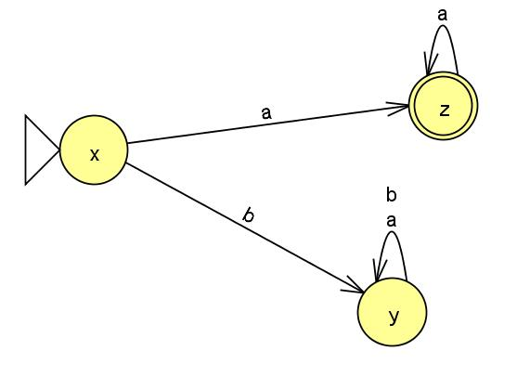
Example:
State Transition Table
The FA is
(Transition Diagram)
RE :
a(a+b)*
Old States | New States
 | Reading a | Reading b
x - | z | y
y | y | y
z + | z | z
b

Slide 9
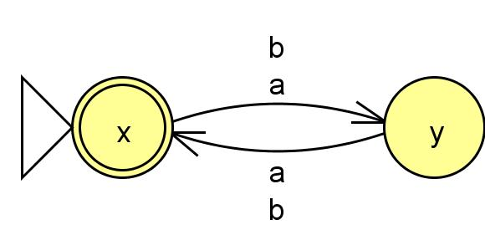
Example:
State Transition Table
The FA is
(Transition Diagram)
RE :
((a+b)(a+b))*
Old States | New States
 | Reading a | Reading b
x ± | y | y
y | x | x

Slide 10
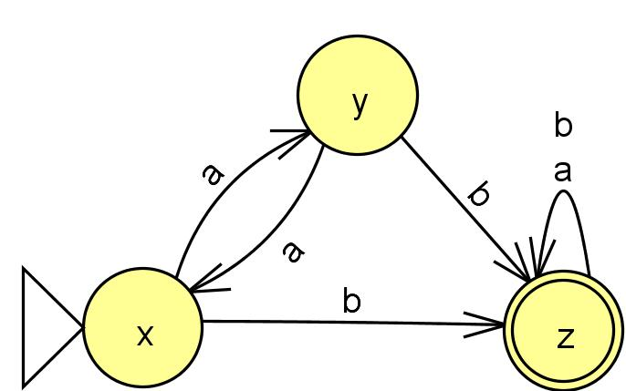
Example:
State Transition Table
The FA is
(Transition Diagram)
It accepts at least one b somewhere in the strings
RE :
(a+b)*b(a+b)* or a*b(a+b)*
Old States | New States
 | Reading a | Reading b
x - | y | z
y | x | z
z + | z | z

Slide 11
Important Notes
If λ is present in the language we can make the FA accept λ by making the start state as the final state.
From every state there will be as many outgoing arrows → as there are letters in the alphabet.
If any RE contains (a+b)* in the beginning we shall first construct the FA by discarding that (a+b)*, the initially discarded (a+b)* will be taken into account by missing arrows & there will be no dead end state.
When all the words of the language (finite) are accepted by the FA then all the missing edges will go to dead end state.

